Slide 1

INT104 – Database Management Systems
Dr. S. Bhaskaran CSE / SOC

Slide 2
Readings
TEXTBOOK
Henry F.Korth, Abraham Silberschatz, Sudarshan. Database System Concepts, McGraw Hill, 6th Edition, 2010.
R.Elmasri, S.B.Navathe. Fundamentals of Database Systems, Addison Wesley, 7th Edition, 2016.

Slide 3
Outline
Database Definition
Types of Databases and Database Applications
Basic Definitions
Typical DBMS Functionality
Example of a Database (UNIVERSITY)

Slide 4
Introduction
What is a database?
Collection of related data.
What is data?
Known facts that can be recorded and have an implicit meaning.

Slide 5
Database Definition
“A database has some source from which data are derived, some degree of interaction with events in the real world, and an audience that is actively interested in the contents of the database”
Implicit Properties of a Database:
Represents some aspect of the real world (Mini-world).
A logically coherent collection of words with some inherent meaning.
Designed, built & populated with data for a specific purpose.

Slide 6
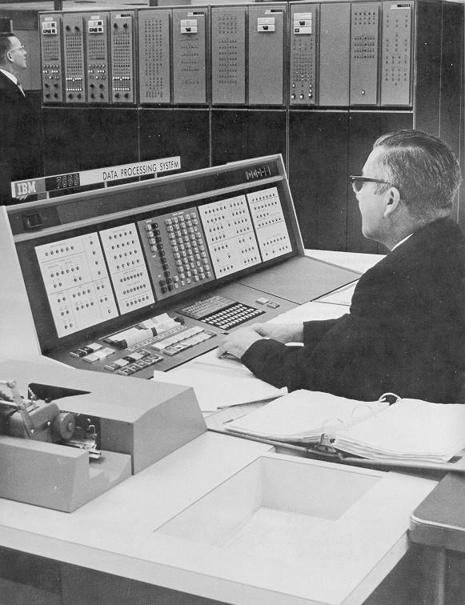
Database Systems: Then

Slide 7

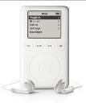








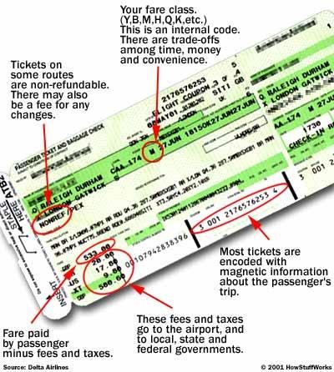

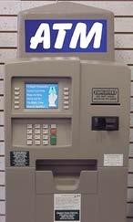
Databases Everywhere

Slide 8
Databases and database systems
Databases and database systems are an essential component of life in modern society
Most of us encounter several activities every day that involve some interaction with a database.

Slide 9
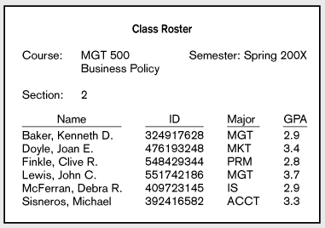
Data in Context
Context helps users understand data

Slide 10
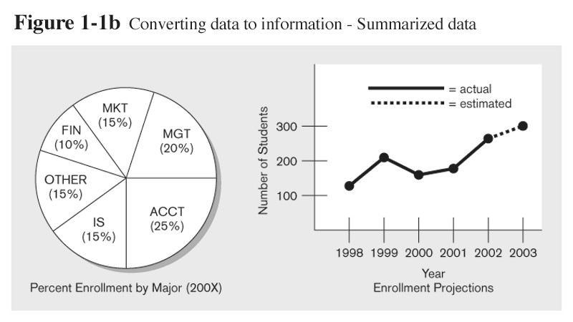
Graphical displays turn data into useful information that managers can use for decision making and interpretation

Slide 11
Types of Databases and Database Applications
Traditional Applications:
Numeric and Textual Databases
More Recent Applications:
Multimedia Databases
Geographic Information Systems (GIS)
Data Warehouses
Real-time and Active Databases
Many other applications

Slide 12
Database Implementation
Defining a database
Data types
Structures
Constraints
Constructing a database
Storing the data itself on a storage medium
Manipulating a database
Querying
Updating
Generating reports

Slide 13
Database Management System (DBMS)
General-purpose software system that facilitates the processes of defining, constructing and manipulating databases.
Can also write your own set of programs to create and maintain the database, i.e. your own Special-purpose DBMS software.
Database + Software == Database System

Slide 14
Users/Programmers
DATABASE SYSTEM
Application Program/Queries
DBMS SOFTWARE
Software to Process Queries/Programs
Software to Access Stored Data
Stored Database Definition
Stored Database

Slide 15


3. Users
Users/Programmers
DATABASE SYSTEM
2. Software
Application Program/Queries
DBMS SOFTWARE
Software to Process Queries/Programs
Software to Access Stored Data
1. Data
Stored Database Definition
Stored Database
4. Hardware

Slide 16
Summary of Basic Definitions
Database:
A collection of related data.
Data:
Known facts that can be recorded and have an implicit meaning.
Mini-world:
Some part of the real world about which data is stored in a database. For example, student grades and transcripts at a university.
Database Management System (DBMS):
A software package/ system to facilitate the creation and maintenance of a computerized database.
Database System:
The DBMS software together with the data itself. Sometimes, the applications are also included.

Slide 17
Typical DBMS Functionality
Define a particular database in terms of its data types, structures, and constraints
Construct or Load the initial database contents on a secondary storage medium
Manipulating the database:
Retrieval: Querying, generating reports
Modification: Insertions, deletions and updates to its content
Accessing the database through Web applications
Processing and Sharing by a set of concurrent users and application programs – yet, keeping all data valid and consistent

Slide 18
Typical DBMS Functionality
Other features:
Protection or Security measures to prevent unauthorized access
“Active” processing to take internal actions on data
Presentation and Visualization of data
Maintaining the database and associated programs over the lifetime of the database application
Called database, software, and system maintenance

Slide 19
Example of a Database
Mini-world for the example:
Part of a UNIVERSITY environment.
Some mini-world entities:
STUDENTs
COURSEs
SECTIONs (of COURSEs)
(academic) DEPARTMENTs
INSTRUCTORs

Slide 20
Example of a Database
Some mini-world relationships:
SECTIONs are of specific COURSEs
STUDENTs take SECTIONs
COURSEs have prerequisite COURSEs
INSTRUCTORs teach SECTIONs
COURSEs are offered by DEPARTMENTs
STUDENTs major in DEPARTMENTs
Note: The above entities and relationships are typically expressed in a conceptual data model, such as the ENTITY-RELATIONSHIP data model (see Chapters 3, 4)

Slide 21
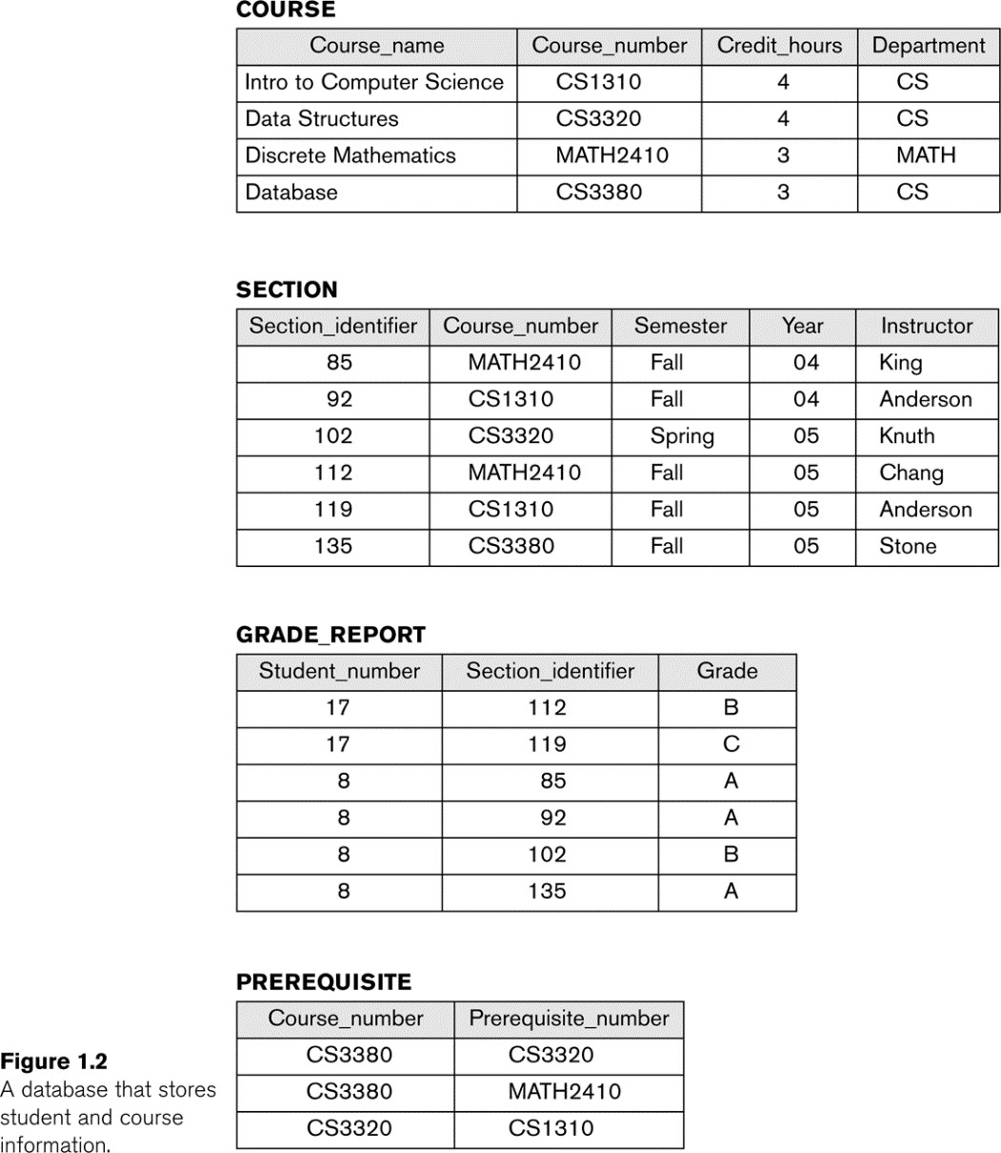
Example of a simple database
STUDENT
Name | Student_number | Class | Major
Smith | 17 | 1 | CS
Brown | 8 | 2 | CS

Slide 22
The Database Approach Vs File Processing Approach
In traditional file processing, each user defines and implements the files needed for a specific application.
redundancy in defining and storing data.
wastes storage space and effort used to maintain the common data up-to-date.
In the database approach, a single repository of data is maintained that is defined once and then is accessed by various users.

Slide 23
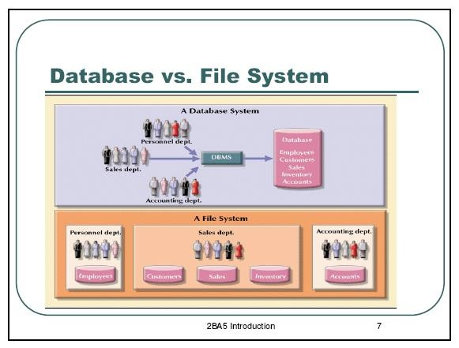

Slide 24



Users/Programmers
DATABASE SYSTEM
Application Program/Queries
DBMS SOFTWARE
Software to Process Queries/Programs
Software to Access Stored Data
Stored Database Definition
Stored Database
Meta-data/
Schema

Slide 25
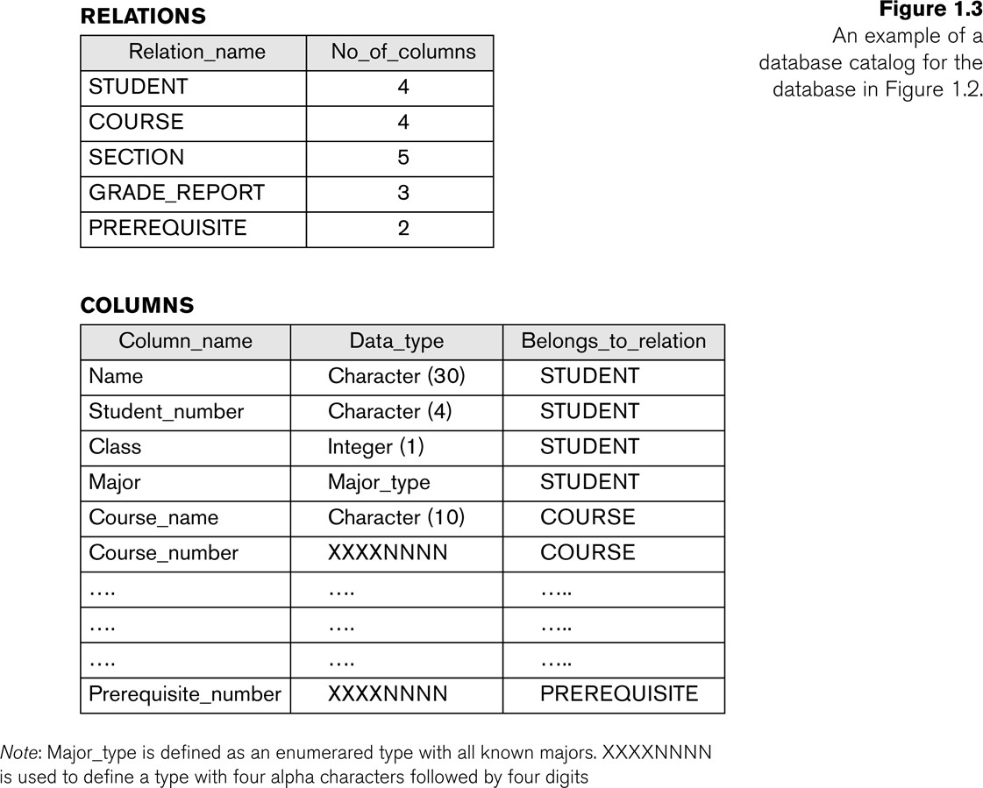
Example of a simplified database catalog

Slide 26

Thank U

